Slide 1
Prompting for Programmers

Slide 2
Agenda
Section 1 – How Models Work
What is a prompt?
Large Language Models (LLMs)
Tokens & Context Windows
Neural Networks (inspired by the brain)
Parameters & Weights (how learning works)
Section 2 – How to Prompt Models well
Why prompt quality matters
Bad vs. Good prompts
A simple recipe for good prompts
Constraints & Non-goals
Prompting frameworks (STAR, CLEAR, CREATE, SPEC)
Advanced techniques (Persona, Chain-of-Thought, Few-Shot)
Professional practices (clarifying, tests-first, diffs, repo context)
AI limitations & gotchas
Wrap Up

Slide 3
What is a prompt?
A prompt is an input (text, code, image, audio, or data) that guides a generative AI model to produce an output.
Prompt:
“What is the capital of France?”
Response:
“Paris”
A generative AI model is a type of machine learning system that learns patterns from data and then generates new, original content that looks or sounds like the data it was trained on.
From Text to Multimodal
Early days: A prompt was almost always a natural-language text instruction (e.g., “Write me a poem about the sea”).
As models improved: Prompting expanded beyond text.
Today’s multimodal prompts can combine:
  Text (questions, instructions, context)
  Images (for captioning, editing, or visual reasoning)
  Audio (spoken commands, sound samples)
  Other data (structured inputs, video, code snippets, etc.)
Key takeaway:
A prompt is now any input—text, image, audio, or a mix—that guides a generative AI model to produce an output.

Slide 4
Prompting for Programmers
Writing prompts that help AI generate code.
Also used for: debugging, explanations, documentation, code completion, learning new APIs
Prompts for programming task are mainly in the form of text based natural language. You make also paste in images or speak to the model.
Prompt Engineering = the discipline of crafting prompts to achieve specific results
  Bad prompt: “Write a Python function” → unclear, random, unhelpful output
  Good prompt: “Write a Python function called add_numbers that takes two numbers and returns their sum. Include an example.”
Takeaway: Clear prompts = better results

Slide 5
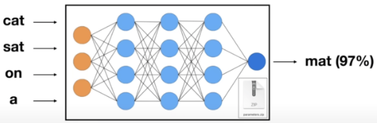
Large Language Mode (LLM)
A Large Language Model (LLM) is a large mathematical system trained on vast amounts of text data.
It learns the statistical patterns of language, enabling it to generate, complete, or transform text.
LLMs work by predicting the next most likely token (a piece of a word) given the previous tokens.
They can:
  Answer questions
  Write essays
  Code
  Summarize documents
Different models = different capabilities
Vary in:
  Size (parameters, training data)
  Modalities (text, images, audio, etc.)
  Context window length
Prompting style may change depending on the model

Slide 6
Examples of Large Language Models
Model | Strengths | Killer Use Cases
GPT-5 / GPT-4.1 (OpenAI) | Strong reasoning, coding, instruction-following, multimodal (text + image) | Code generation, tutoring, text-to-image reasoning, long context tasks
Claude (Anthropic) | Safe, reliable, consistent text, long context windows | Document analysis, summarization, safe enterprise use
LLaMA (Meta, open source) | Open source, customizable, efficient on smaller hardware | Fine-tuning for specific domains, research, private deployments
Mistral / Mixtral | Very fast, optimized inference, strong open-source ecosystem | Lightweight chatbots, embedding models, scalable open-source apps
Gemini (Google DeepMind) | Multimodal (text, image, audio, video), integrated with Google ecosystem | Multimodal tasks, search integration, productivity tools

Slide 7
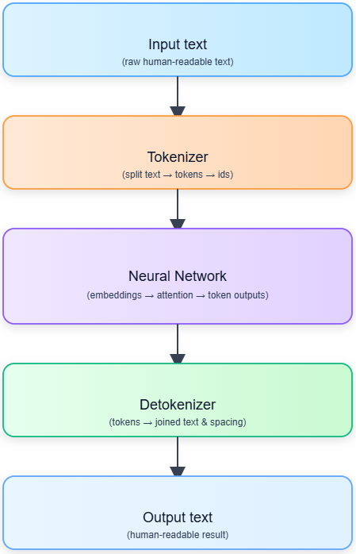
Tokens
A token is a chunk of text (can be a word, part of a word, or punctuation)
  Example: “Programming” → “Pro” + “gram” + “ming”
A token is the unit a model actually reads and writes
Tokens turn messy, variable-length text into a tidy sequence of discrete units (indices) that neural networks can work with efficiently
Tokenization is the process of turning words into tokens
Detokenization is taking the model’s output tokens and converting them back into readable text.
Model cost and limits are based on number of tokens
The Tokenizer Playground - a Hugging Face Space by Xenova

Slide 8
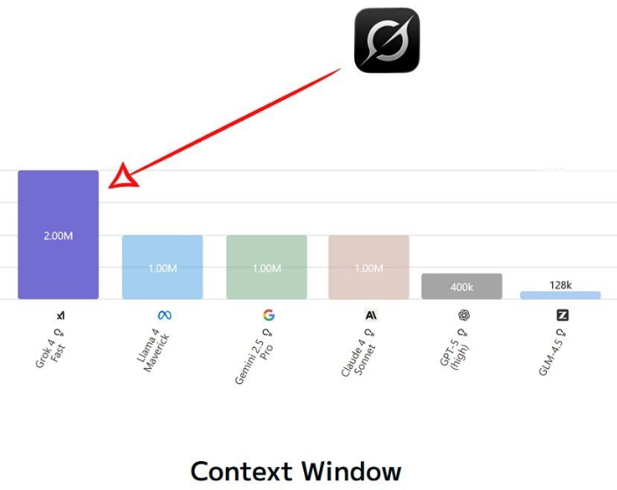
Context Window
The maximum number of tokens the model can “see” at once
Think of it as the model’s short-term memory — everything inside the window can influence the answer, anything outside it can’t.
Includes both prompt + response
If the window is exceeded, older tokens are dropped
Larger windows = more context the model can handle (FYI: King James Bible has about 1 million tokens)

Slide 9
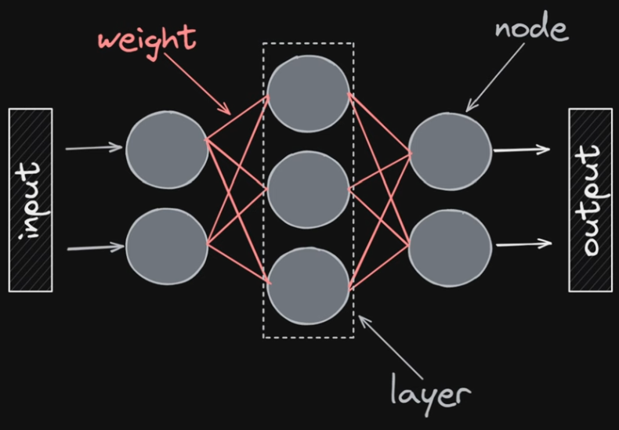
What is a Neural Network?
Inspired by the structure of the human brain
Made up of artificial neurons (mathematical units) arranged in layers
Each neuron receives inputs, applies a weight, and passes on an output
Learns by adjusting the weights during training (like strengthening/weakening brain connections)
But: it’s a very simplified model — it captures the idea of neurons and connections, not real biology
Key point:
A neural network is a mathematical abstraction, loosely inspired by the brain, but not a faithful replica.

Slide 10
Parameters & Weights in Neural Networks
Parameters = the internal values a model learns during training
In neural networks, most parameters are weights and biases
Weights: numbers that scale the strength of a connection between two neurons
Biases: extra values that shift outputs, allowing flexibility
During training, the model adjusts weights and biases to reduce error → “learning”
Key point:
Parameters (weights + biases) are what the network learns from data.

Slide 11
Weights record patterns from training data
During training, the model sees many examples (text, code, images, etc.)
Each example adjusts the weights slightly, using a process called backpropagation
Over time, weights get tuned to reflect statistical regularities in the data
Example:
  If “dog” often appears near “bark,” connections between those tokens get stronger
  The weight values store this association
The final set of weights = a mathematical memory of patterns learned from data
Key point:
Weights don’t “store facts” directly — they encode the probabilities and relationships that the model has learned.

Slide 12
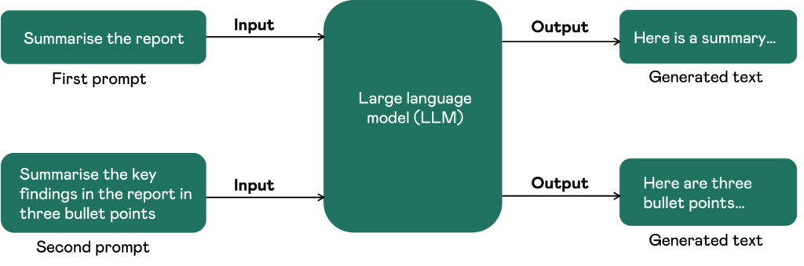
How Prompts Shape Output
AI generates code based on patterns it has seen
Vague prompts = too many possibilities → errors & hallucinations
Good prompts = narrowed focus → useful results
Analogy: “Go to the city” vs. “Go to 221B Baker Street”

Slide 13
4 Steps to Better Prompts
Define what you want
Specify the language or tool
Give an example
State how it should look
Following these steps makes AI help reproducible

Slide 14
Recipe in Action
❌ Bad: “Make a calculator” → too vague
✅ Good: “Create a Python function called calculate that can add, subtract, multiply, and divide two numbers. For example: calculate(5, 3, '+') → 8. Return result as a number.”
Takeaway: Clear, specific prompts yield better results

Slide 15
Why Constraints Matter
Constraints = rules/boundaries for AI output
Keep solutions within project requirements
Examples:
  Tech stack: Python 3.11, Node 20
  Code style: ESLint, Prettier
  Performance: <200ms response time
  Security: no eval(), validate all inputs

Slide 16
Preventing Scope Creep
Non-goals = what AI should not change
Protects against “helpful” but harmful changes
Examples:
  ❌ No DB schema changes
  ❌ No new dependencies
  ❌ No UI modifications

Slide 17
Professional Prompting Frameworks
⭐ STAR: Situation, Task, Action, Result
🎯 CLEAR: Context, Length, Examples, Audience, Role
🚀 CREATE: Character, Request, Examples, Adjustments, Type, Extras
SPEC: Specific goal, Language/Tool, Example, Constraintslecture3-prompting-for-programm…
Tip: Pick one framework and stick with it

Slide 18
Advanced Techniques
Persona Pattern: “Act as a senior Python developer and security expert” → more relevant insights
Chain-of-Thought: “Think step by step, show your reasoning” → transparent answers
Few-Shot Prompting: Provide examples → AI mimics style/output format

Slide 19
Prompting in Real Projects
Clarifying Questions: confirm goals, constraints, deadlines before coding
Tests-First Prompting: write tests first, ask AI to only generate code to pass them
Patch/Diff Style: ask for diffs, not full files → easier review
Repo Context: give file paths & rules so outputs align with project

Slide 20
AI Limitations & Gotchas
🚫 No real-time data, no full project context
⚠️ Can hallucinate APIs, miss edge cases, suggest insecure patterns
✅ Your defense:
  Always test the code
  Ask for explanations
  Cross-check docs
  Start simple, add complexity

Slide 21
Wrap Up
A prompt is an input (text, code, image, audio, etc.) that guides a model to produce output.
LLMs are large neural networks trained on vast text + code, using tokens and context windows.
Prompts shape output quality: clear, specific prompts lead to better results.
Use recipes, frameworks, and constraints to write effective prompts for programming.
Advanced methods (persona, chain-of-thought, few-shot) unlock more control.
Always remember AI limitations: test, verify, and stay in charge as the programmer.

Slide 22
Practice: Write Your Own Prompt
Task:
Write a prompt for AI to generate a simple Python program that greets a user.
Hints (use the 4-step recipe):
What do you want? (a greeting program)
What language/tool? (Python)
Give an example:
  Input: "Alice" → Output: "Hello Alice!"
  Input: "Bob" → Output: "Hello Bob!"
How should it look? (simple, clear, commented code)

Slide 23
Resources
https://www.promptingguide.ai/

